Slide 1
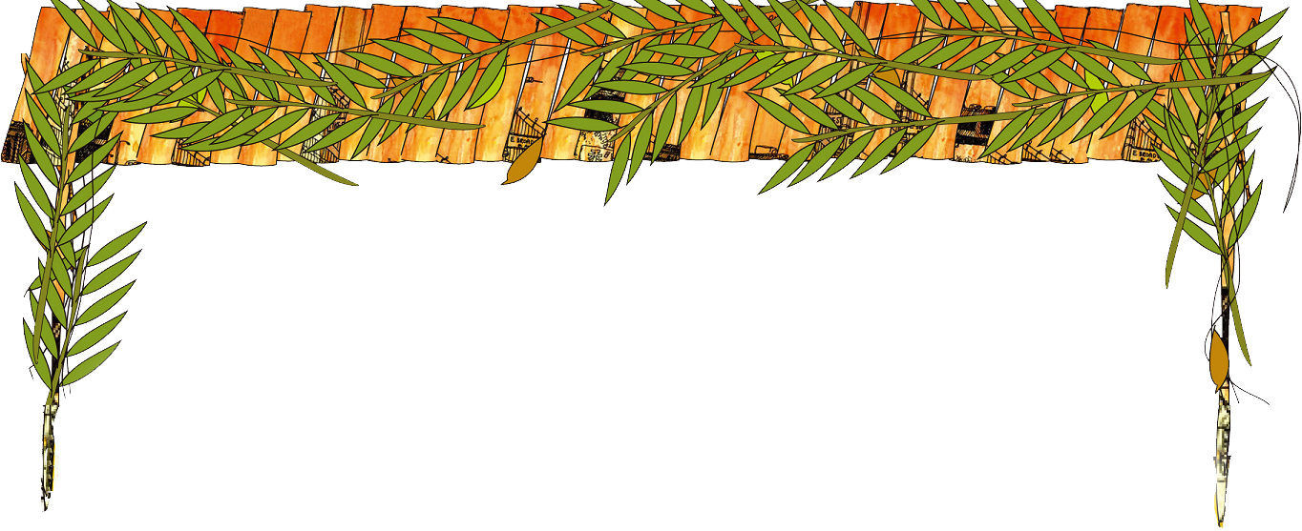

住棚節節期1:
吹角節—悔改, 獻祭
9/8

Slide 2
來源 (References)
Word of Grace Ministries, Message from Clinton Glenny
IHOP-KC Missions Base, Grafted-In Seminar, The Prophetic Significance of the Biblical Feasts – Katherine Eibel
以琳書房禱告日誌(TOD)

Slide 3
吹角節—悔改, 獻祭
Notes:
由於陽曆和陰曆的長度不一致，猶太節期在陽曆上的日子會每年變動。

Slide 4
秋季節期
秋季節期的準備開始於吹角節的悔改
Ten Days of Awe：
> 吹角節9/25/2014提斯利月第一日 The Feast of Trumpets (Rosh Hashanah)
> 贖罪日10/4/2014提斯利月第十日 Day of Atonement (Yom Kippur)
Notes:
A Devine appointment – a time to meet with God. It declares the entry of a period of repentance, a period of atonement. It ends at the holiest day in the year, the Day of Atonement (Yom Kippur). There is no other nation in the world devoted 10 days to repent, to soul searching. To calculate their sins.

Slide 5
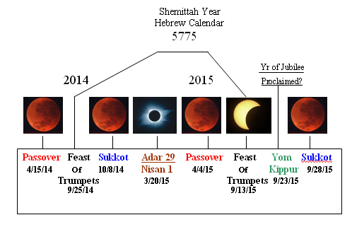
1949,1967
1949,1967
1949,1967
1950,1968
1950,1968
1950,1968
1950,1968
1950,1968

Slide 6
轉從義人的智慧
哈該2:6-9 萬軍之耶和華如此說、過不多時我必再一次震動天地、滄海、與旱地．我必震動萬國…這殿後來的榮耀、必大過先前的榮耀．在這地方我必賜平安．這是萬軍之耶和華說的。
Notes:
So important so that 2 prophets said it twice. Hebrew12:27: 、『再一次我不單要震動地、還要震動天。』 這再一次的話、是指明被震動的、就是受造之物、都要挪去、使那不被震動的常存。
所以我們得了不能震動的國Are you afraid of shaking, a global Recession? Yet God promised the glory of the latter house shall be greater than the previous one. You cannot be in peace when your finance will not be secure. Ahead of this land will be in darkness, God will lead you through ‘stuff’ in ahead of time. After you are tried like silver and gold a head of time, you will never react to shaking anymore. You know what’s going to happen on the earth in the time of fullness. 被震動的都要挪去、使那不被震動的常存。 所以我們得了不能震動的國You will never be worry about bills again. When God is shaking the earth, you will be in peace. Since you are already in advanced knowledge of God.
If God does not deal wit you ahead of time, you will always react. You cannot prepare for what you don’t know. God does not react. Because He stands out of it. If you are not ahead of time, you are serving time. Understanding feasts is Advanced knowledge – Jews put the blood of lamb at door post ahead of time. Noah had 125 years of preparation time. When you come to the portal of feasts, Faith is the future God call it now.
So are you going through stuff? Be glad when you are tried like gold and silver. Since you are selected to be Noah who knows advanced knowledge. To be part of the latter glory.
當我們進入神節期的奧秘裡，就是進入超越時間的智慧裡。與神合作，讓神預先熬練我們，震動我們，除去我裡面會被震動的，使那不能被震動的能夠長存。裡面有個君尊皇族覺醒，知道自己是誰，興起站在位上。不與世人反應一樣，而是進入超越時間的智慧裡，通達時務，而且有分於後來的榮耀。
黑暗遮蓋大地，幽暗遮蓋萬民，人心慌慌不定時，唯獨神的家，就是教會是有光，有糧的，萬國要來救我們所發現的光輝。就像神在埃及施行審判，遍地黑暗，唯獨以色列家中有亮光，也像乃幔將軍，來以色列尋求醫治。
2014、2015聖靈會更大的澆灌，靈魂大收割的日子。神的聖殿會充滿榮耀。就是約珥書：聖靈大大充滿在地上，兒女要說預言，少年人見異象，老年人異夢，神蹟奇事遽增。

Slide 7
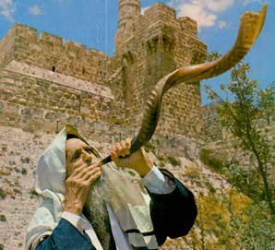
吹角節—悔改
警告悔改: 以色列以此為新年， 吹角節Rosh Hashanah =“一年之始”,“世界的誕生日”,”創造的紀念日”
猶太新年是與神之間細心自省的時刻 (利23:23-25; 民數記29:1):吹角守節一天「叫醒」猶太人离恶行善
Notes:
The fullness of time. 1.吹角節── 吹角節是神國的起床號。我們的靈會常常睡著，所以神想辦法把我們吹醒，免得我們被魔鬼吞吃。
可畏的日子── 這十天內，神要我們特別多花時間親近神、尋求神。
2.贖罪日── 這是為了過去的錯誤和玷污悔改，以恢復我們與神的關係。神規定百姓要在這天禁食，清理靈裡所有的垃圾，預備潔淨身心靈，暢通屬靈的管道，好讓我們能毫無攔阻的與神面對面。
And 3. Sukkot

Slide 8
吹角節
吹角一百響:
1.Tekiah 一聲长響 ― 王的加冕.
2.Shevarim 三聲中长度，如哭泣般的吹角 ― 猶太人心中的痛哭，渴望与神连结，成长，並逹成被造的命定.
3.Teruah 九聲急促短響 ― 警鐘，由沉睡中唤醒.

Slide 9
吹角節- 獻祭
吹角節是聖會，為安息日不可作工，百姓要到會幕前聚集，所有的燔祭都要與贖罪祭同獻
 | 燔祭 (全部燒給神) |  |  | 贖罪祭 (燒上脂油的部份)
 | 公牛犢 | 公綿羊 | 公羊羔 | 公山羊
月朔 | 2 | 1 | 7 | 1
吹角節 | 1 | 1 | 7 | 1
Total | 3 | 2 | 14 | 2

Slide 10
在對的時間作對的事，就是智慧！
額外的獻祭(平時十一奉獻以外):利23:37-38耶和華節期…要將火祭燔祭,素祭,祭物,並奠祭各歸各日獻給耶和華.在耶和華的安息日以外,又在你們的供物和所許的願並甘心獻給耶和華的以外
The Law of Common / Average / Selfish vs.
The Law of Purpose / Plenty
Notes:
Why this is important?<Put on helmet. Fasten the safety seat belt! Tell people next to you: I will not be offended by the word”. >
Unless you are in Abraham’s covenant, the church cannot be a blesse in global recession. The church should be in prosperity because God is prosperous. Our God is nothing but prosperity. The temple was all gold everywhere. It takes 270B to build the temple now.
How many of you titer? How many of you give offering?
Jews lay down the seed of titer + offer at this time of year when portal is open. That’s how your next year is measured. You only want a normal year? How many of you know we are not in normal time? God has got something for you that you don’t know of. This is the season of double portion. The former and latter add together.
If we don’t lay down the seed, what is going to be laid down? Who has garden in the backyard? If you have a garden without seeding vegie or fruits, what’s going to come out? Weeds.
The Law of Purpose/Plenty:
Connected to Heaven’s Hedge Fund. A Jew (Newman) created this on the Wall St in 1920. A Limited Private Investment which use all sorts of sophisticated highly risky & reliable investment strategies. To goal is to earn high return. Limited Private Partners are responsible to reflect to the dimension which he or she invested. A famous hedge fund investor who is still alive is George Sorous.
e.g., A family in our church,一位弟兄used to be POOR and selfish, cares only his family, desperate to make his house very clean and rich. All his goal of life was to earn benefits, even intended to marriage with a wife who is like him, very good at earning lots of money, and himself being very stingy saving costs as much as he could. But gradually made the turn to a law of purpose, to live for providing God’s house, happily open his house for cell gathering allowing kids to mess up his house, happy to provide money/time to God’s house, and even bless his wife when his wife wanted to quit her job to make more time to serve God and serve family. His purpose has changed from ‘selfish’ to ‘providing plenty for God’s house’ . During Passover feast in 2013, this couple 十一奉獻以外額外的奉獻的$1000 got x100 return。這就是Law of Purpose/Plenty。
“Should seek for His kingdom and His righteousness, all others will be given to you”.
Now tell people next to you: There is nothing mediocrity in me! God’s purpose is my purpose! I am in the law of purpose! I am in the law of plenty! My house is God’s house.

Slide 11
在對的時間作對的事，就是智慧！
列王紀上8: 2就是七月在節前、以色列人都聚集到所羅門王那裡…62-65所羅門向耶和華獻平安祭、用牛二萬二千、羊十二萬、這樣、王和以色列眾民、為耶和華的殿行奉獻之禮.
當日王因耶和華殿前的銅壇太小、容不下燔祭、素祭、和平安祭牲的脂油、便將耶和華殿前院子當中、分別為聖、在那裡獻燔祭、素祭、和平安祭牲的脂油
Notes:
Solomon’s seed was in 10K’s. When Solomon lay down the seed of his offering. God told him萬國所羨慕的必來到〕我就使這殿滿了榮耀…銀子是我的、金子也是我的。All he needed to say is Father give me the wisdom! God gave him everything. All nations came here to see this glory.
I challenge you to pray with your spouse for a number to offer to God during Sukkot, and make this offer at Sukkot in Sept.

Slide 12
吹角節–七號
吹號不但宣告而且釋放世上的國成為我主和主基督的國:
約書亞攻打耶利哥，第七天要繞七次然後吹號於是耶利哥城倒塌:對應於吹角節是在猶太曆的第七個月份的月塑吹號，啟示録第七位天使的號聲
耶穌名字希伯來語就是約書亞
Notes:
Remember what the drama played, the wall of poverty, the wall of addition fell when you went to the proximity of the portal. Do you know why the wall of Jericho fell before Joshua? Because Rosh Hashanah is the time for breakthrough. Whatever blocking you will fall.
Why the red sea separate? Not the faith of Israelites, but that was the time of Passover - deliverance. When Israel came to the red sea at the time of deliverance, what is blocking will separate. Feast is the proximity of what you are looking for.
When it’s the set time and you came to the right place at right time, it’s going to happen anyhow. If it is going to happen anyhow, and the time is set, and you have great faith, I wonder how much more you are going to receive.
Turn to the next person say ‘something new is shifting for you – you are going to possess’!
This is a very prophetic time right now. Because this is the time for fullness - possession. God opened the heaven portal to let us take possession. When you come to the portal the wall will fall. No matter what kind of wall. 號聲:宣告而且釋放末了的榮耀和爭戰來到，Transition from anointing to glory參與在神得地為業的行動，進入新的季節. Jesus came did not conform with the matter on this earth. He conformed with the words. That’s why he walked on the water because he walked on the word not on the water. Peter did not walk on the water neither. When Peter turned his eyes from Jesus (words) to the water (matter on earth), he fell. When we observe the feast, the set time of God, the portal, we conform to the words, not the matter on earth. So matter does not matter anymore. There is nothing in poverty, weak and brokenness in God. What we are conformed with, the word, is Abraham’s blessing. Whatever blocking us will fall.

Slide 13
吹角節--迎娶新婦
吹角節也指向耶穌是新郎来迎娶新婦(教會):
古以色列只有新郎的父親知道大婚之日的凖確日期.受邀的客人必须预备灯油，在大婚之日於路旁点灯庆祝婚礼。
太(Matthew) 24:42 所以你們要儆醒、因為不知道你們的主是那一天來到。
Notes:
In What celebration that Jews will blow the trumpet?
There is Shofar Sounding at Jewish Weddings
而新郎新妇都只会知道大婚之日预备的大概情况，受邀的客人只会知道大婚之日可能快到了 – 必须预备灯油，在大婚之日於路旁点灯庆祝婚礼。
當教會失去耶和華節期的規範的啟示，就無法預備，結果就像馬太福音25章，五個愚拙的童女，不警醒，沒有預備油，主耶穌再來時，反應不及。
神藉著節期的觀念set time.，清楚地告訴我們他作事的時候，雖然我們不知道主耶穌哪一天來，但我們知道主來的季節
Hearing the trumpet blowing at Rosh Hashanah now, we will be reminded, hey, have you been faithful to God, and get oil ready. If not, repent, turn around make things right when it’s not too late.

Slide 14
吹角節
Play YouTube “Israel Prep for Rosh Hashana”
Notes:
<Last 5 min Card!>

Slide 15
吹角節 Summary 1
我接受主的邀請與祂一起在吹角節警醒,在吹角節突破的天門打開時,推倒攔阻我的高牆:
Notes:
This is the time of repent and possession. This is the time of searching my soul. To make my heart right in front of God. God is turning your circumstance around when we turn away to God.
Joel, Hagai, and Paul literally speak about the same time. Fear not oh the land be glad and rejoice! Repent and you will possess at Rosh Hashana.
<let’s wait upon the Lord 2 min, listen to what is the wall in my life to fall?

Slide 16
宣告出你的耶利哥城牆,呼喊使它倒下
1.更新自己對神愛的關係…(e.g.,認識神卻變得不冷不熱？)
2.對自己的家庭生活重新檢修、
3.對自己的人際關係加以重整、
4.對自己的金錢產業重新承接、
5.順服權柄尊重次序…
6.對自己的公民責任重新認識、祝福以色列
Notes:
<Let’s all stand up, shout to the Lord. Let the wall fall……declare what is falling down!><5 min>
Release your expectation for Rosh Hashana! Be glad you children of Zion and rejoice, when you are facing your circumstance. So be glad and rejoice. God is turning it around. Devil has retracted us with circumstance. So you turn away from circumstance to rejoice, God will turn your circumstance around.
This is the time of break through.

Slide 17
吹角節 Summary 2
為過去曾經心裡暗暗排猶岐視,從未關心過猶太人而認罪悔改
也為長兄以色列禱告，我們的猶太長兄們対神向他們曉豫的吹角節蘇醒過來
耶 31:33-34耶和華說…我要將我的律法放在他們裏面,寫在他們心上.我要作他們的 神,他們要作我的子民.他們各人不再教導自己的鄰舍和自己的弟兄說‘你該認識耶和華’因為他們從最小的到至大的,都必認識我
Notes:
<2-3 people as a group, repent for careless for Jews. Pray for Jews.><3 min>

