Slide 1
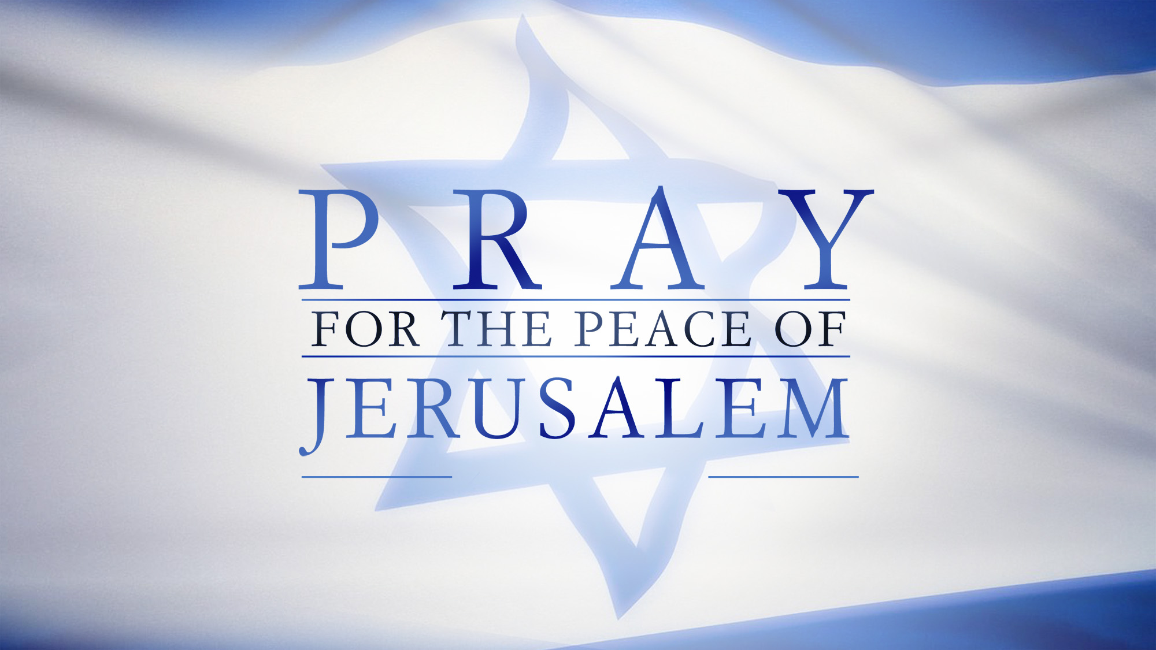

Slide 2
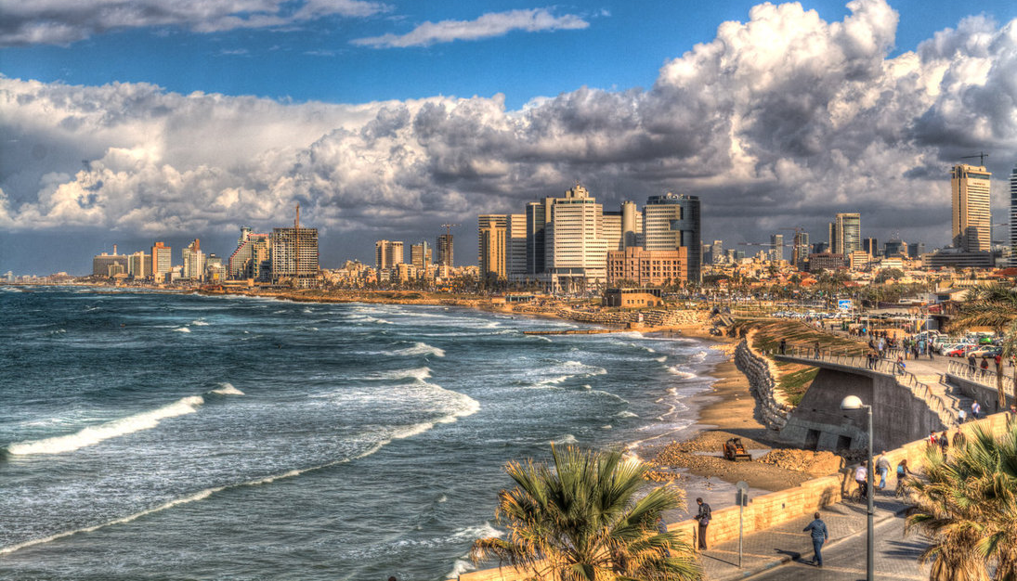
特拉維夫 .Tel Aviv. תֵּל־אָבִיב

Slide 3
特拉維夫的開始
1909: 66 families (Zionists) build 66 homes
1917-1948: Forced to leave, came back, Jews flee to this city due to persecution in Europe
1948-Present: Independence & Continued development

Slide 4
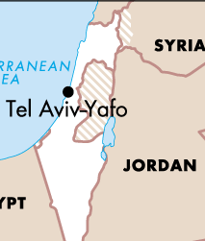
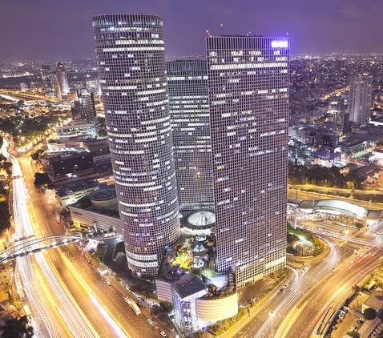
特拉維夫 .Tel Aviv. תֵּל־אָבִיב
Population: 414,600 (2nd largest city)
Economy: 2nd-largest economy in the Middle East after Dubai
Economic: Tel Aviv Stock Exchange
Technology: World’s top 10 tech centers
Known as:
"The City that Never Sleeps”
“Party Capital” (24 hr. culture)

Slide 5
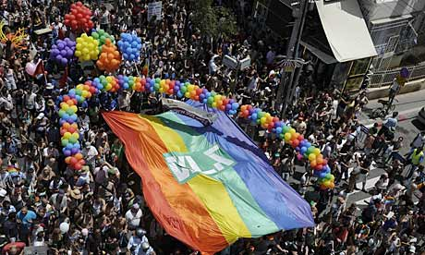
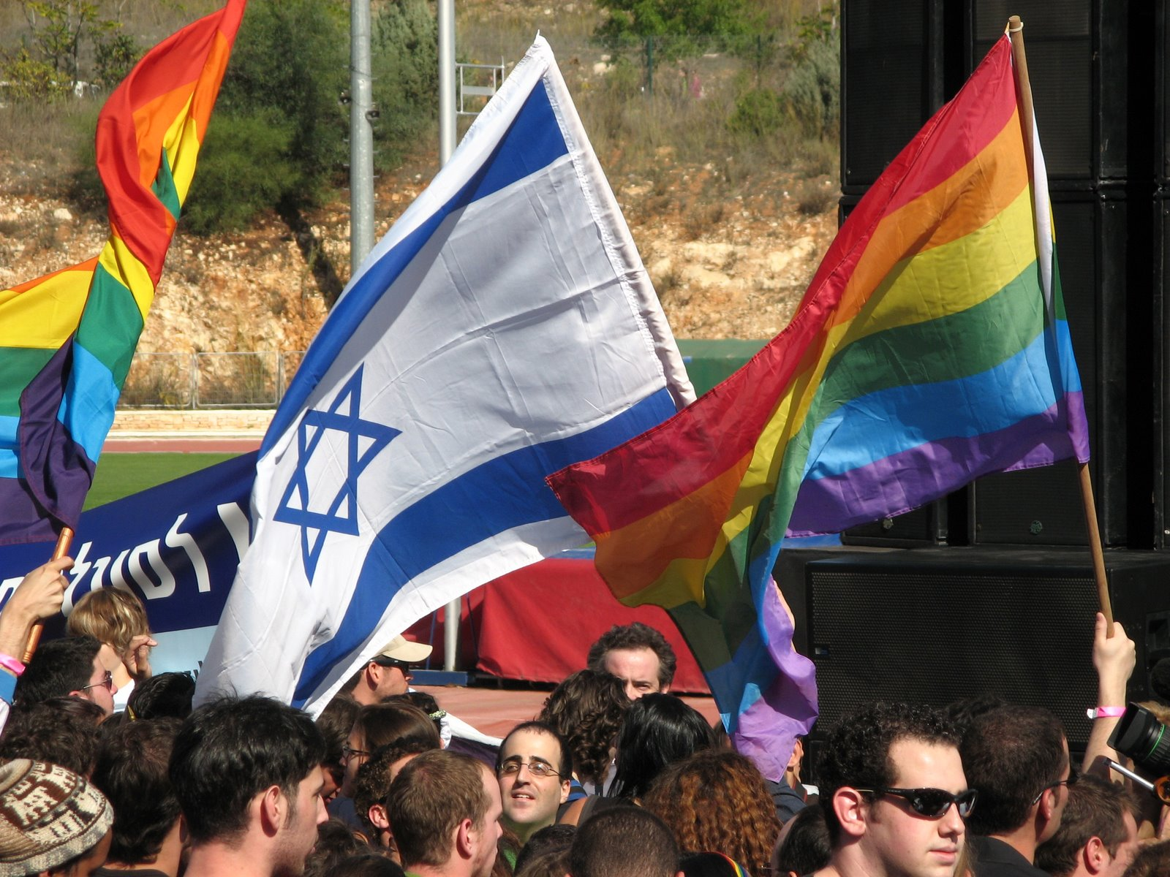
特拉維夫 .Tel Aviv. תֵּל־אָבִיב
Huge LGBT Culture (like S.F)
LGBT Film Festival
Gay athlete team
Largest annual gay parade in the M.E. and Asia
One of most popular destinations for LGBT tourists internationally

Slide 6
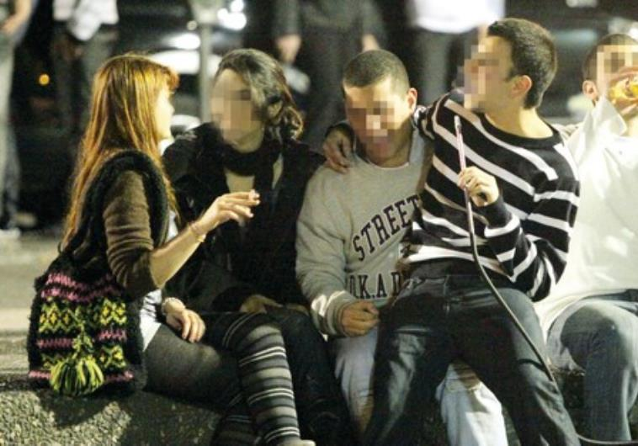
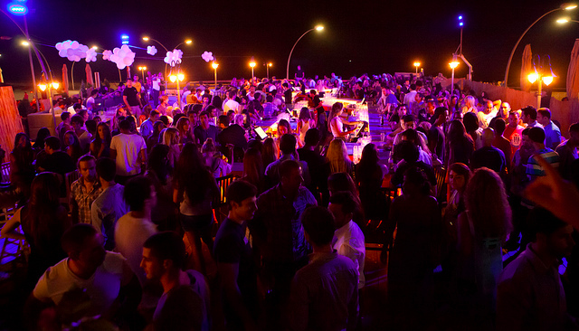
特拉維夫 .Tel Aviv. תֵּל־אָבִיב
Young Adults (18-34 yr old): 1/3 of population
Singles: 44.8% of men and 42.3% of women
They come to Tel Aviv seeking:
Higher Education: above national average (20 academic institutions)
Work: Tech and financial jobs
Rich Cultural Life: Art & music
Great Parties

Slide 7
特拉維夫 .Tel Aviv. תֵּל־אָבִיב
All Israel: 20,000 abortions/year
Highest rate: 25- to 34-year-olds
Most abortions are through abortion pills
Young people of all ages can have abortions without parental consent
Right is supported by penal code
Teens up to the age of 19 and soldiers can have fully funded abortions

Slide 8
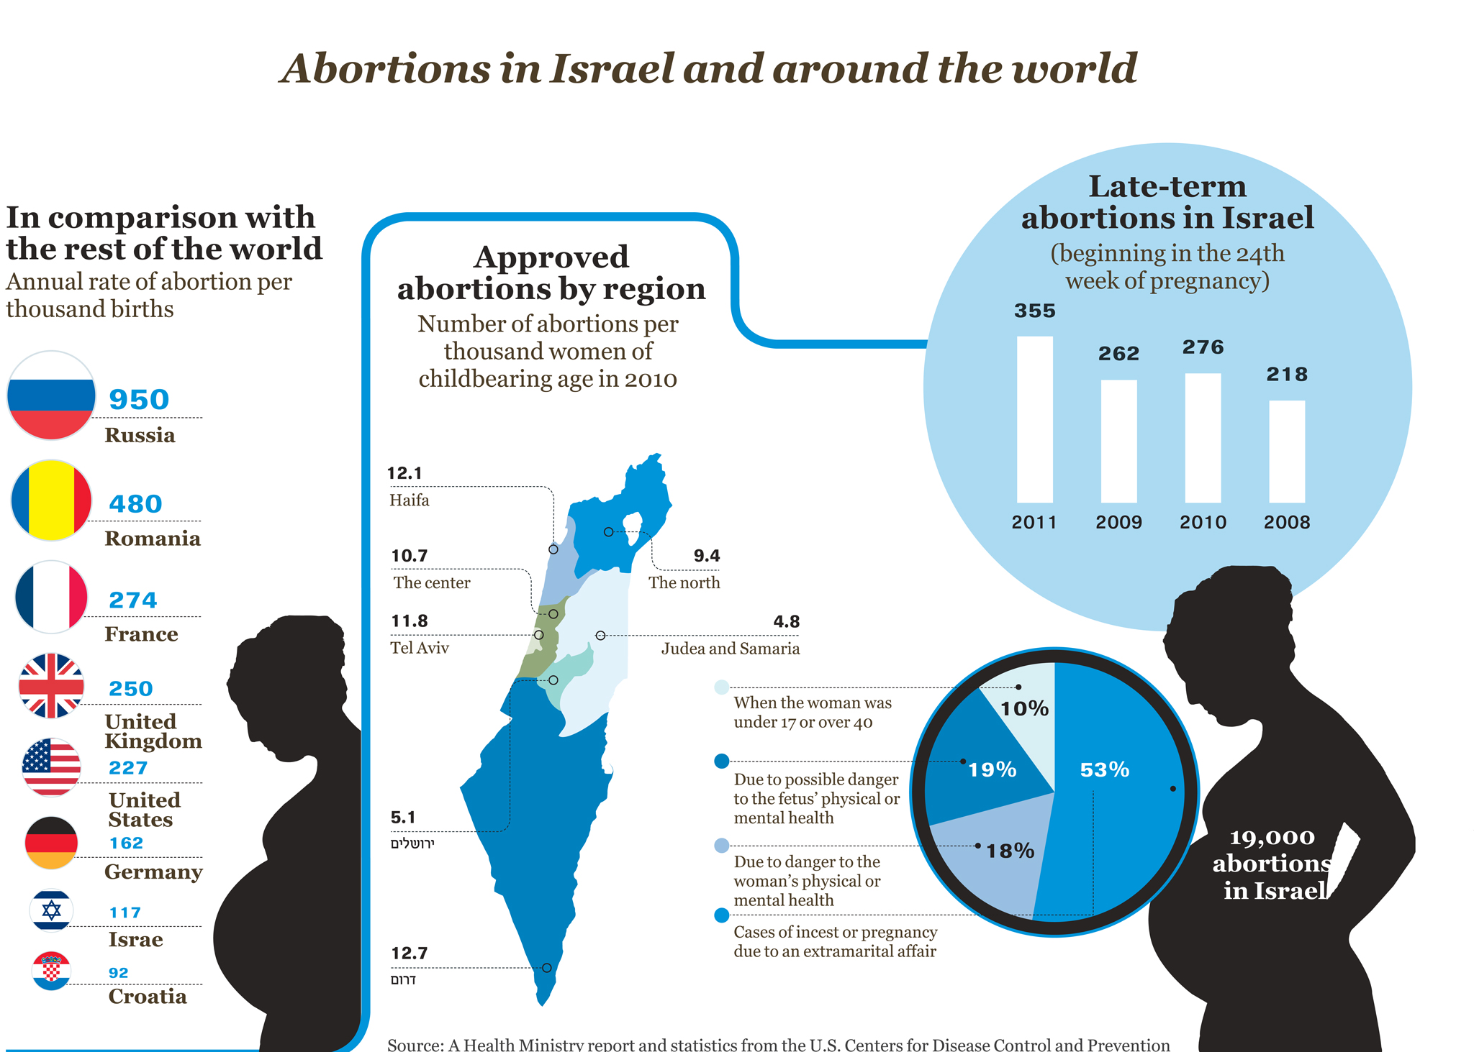

Slide 9
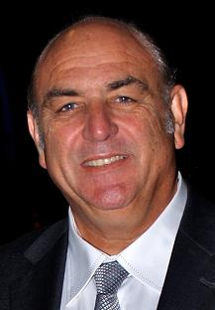
特拉維夫 .Tel Aviv. תֵּל־אָבִיב
Rates of anger, risky behavior, recreational drinking of alcohol, physical inactivity, long hours of computer use…remain high among Israeli youth, according to Dr. Yossi Harel-Fisch... His surveys showed that during the intifadas, Palestinian terror caused serious harm to the psyches and moods of Israeli teens. Those who had emotional support from at least one parent did much better than others, Harel-Fisch said. “Parental involvement has a major buffering effect,” he said.

Slide 10
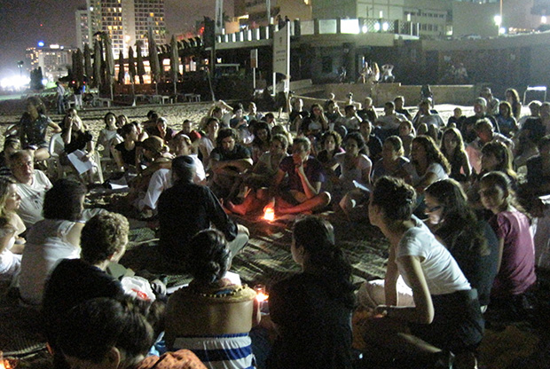
Tel Aviv: Attendance at synagogues and religious events growing
Religious-secular divide
Yet increased interest in religious activities
“Those who get involved in the city’s religious life are primarily single young professionals—a mix of immigrants and native Israelis, traditional Jews of all streams, and some who define themselves as secular.”

Slide 11
禱告1
－為特拉維夫親年人的救恩禱告
以後，我要將我的靈澆灌凡有血氣的。你們的兒女要說預言；你們的老年人要做異夢，少年人要見異象。(珥2:28)
求我們主耶穌基督的神，榮耀的父，將那賜人智慧和啟示的靈賞給你們，使你們真知道他 (弗1:17)

Slide 12
禱告2
－代表特拉維夫的親年人悔改
14 這 稱 為 我 名 下 的 子 民 ， 若 是 自 卑 、 禱 告 ， 尋 求 我 的 面 ， 轉 離 他 們 的 惡 行 ， 我 必 從 天 上 垂 聽 ， 赦 免 他 們 的 罪 ， 醫 治 他 們 的 地 。
(代下 7:14)

