Slide 1
感恩季節裡對以色列的祝福
週日 11/22/15

Slide 2
恐怖份子的攻擊 11/19/15
Source: STANDFORISRAEL.ORG, ISRAELNATIONALNEWS.COM
Notes:
November 19 (Thursday), two Israelis dead and two have been wounded after an Arab terrorist stabbing attack in Tel Aviv.
a 32-year-old and a 51-year-old
The incident took place in parking lot at an entrance to a synagogue as afternoon prayers were taking place. One victim was declared dead at the scene, and the other one was rushed to the hospital with serious injuries.
a 32-year-old man was lying (on the ground) unconscious, without a pulse and not breathing, after suffering from stab wounds to his upper body.
Close to him lay a 30-year-old man with stab wounds to his upper body, and a floor below we located an additional casualty, a man of about 50, fully conscious.
http://www.blog.standforisrael.org/articles/two-killed-in-stabbing-attack-in-tel-aviv
http://www.israelnationalnews.com/News/News.aspx/203647#.VlD7qd-rQ3E

Slide 3
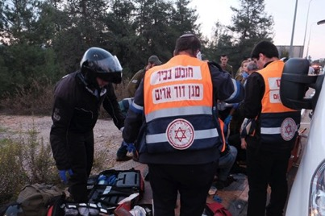
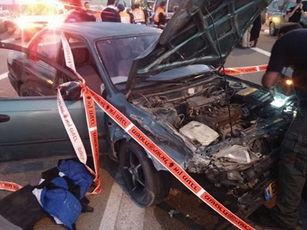
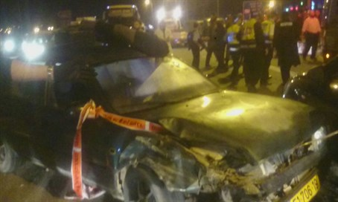
恐怖份子的攻擊 11/19/15
Source: STANDFORISRAEL.ORG, ISRAELNATIONALNEWS.COM
Notes:
Second terror attack
Three people – two Israeli and one Palestinian – have been murdered and another seven wounded on Thursday afternoon in a shooting attack ten minutes south of Jerusalem.
Of the victims, several are reportedly citizens of the United States.
18-year-old， 50-year-old victim, and a Palestinian man who had been standing nearby…
Two terrorists involved in the attack were shooting on their cars and used their car as a weapon to run over people

Slide 4
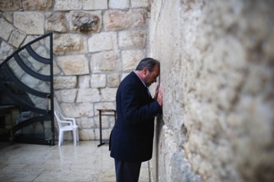
Ezra Schwartz, an 18-year-old American student and volunteer who was delivering food to IDF soldiers.
Yaakov Don, a beloved 49-year-old teacher and father of four.
Shadi Arafa, a 24-year-old resident of Hebron who was driving home from work.
Reuven Aviram, a 51-year-old husband and father who had made aliyah (immigrated to Israel) from the former Soviet Union in 1990.
Rabbi Aharon Yesiab, a 32-year-old father of five, stabbed as he left a prayer service.
Source: STANDFORISRAEL.ORG
Notes:
http://www.blog.standforisrael.org/articles/pray-for-the-recent-victims-of-terror-in-israel

Slide 5
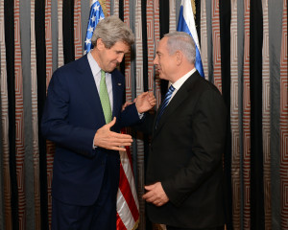
約翰·凱瑞下週造訪以色列
11/24會跟現任以色列總理Benjamin Netanyahu和巴勒斯坦總統Mahmoud Abbas碰面
說是會談到解決暴力問題的方式
Source: STANDFORISRAEL.ORG
Notes:
Next Tuesday 11/24
美國民主黨政治人物 U.S. Secretary of State John Kerry will visit Israel next week in hopes of helping stop the ongoing violence:
U.S. Secretary of State John Kerry will visit Israel and the Palestinian territories to discuss ways of stopping the violence and the implementation of confidence-building measures.
He is scheduled to meet with both Prime Minister Benjamin Netanyahu 班傑明·納坦尼雅胡 and Palestinian President Mahmoud Abbas 巴勒斯坦自治政府主席阿巴斯
on Tuesday.
The visit will be Kerry’s first in over a year.

Slide 6
歐洲反猶太主義
歐盟執委會 (European Commission) 宣布一個新的政策：將1967年Six-day War之後屬於以色列的地區(ex: West Bank, Judea, east Jerusalem, Golan Heights) 所出的產品標誌為“Made in Israeli Settlement” 不是 “Made in Israel”
暗示這些地區不是真正屬於以色列的，讓人覺得以色列違法地居住在那
Source: STANDFORISRAEL.ORG
Notes:
This week the European Commission announced guidelines suggesting that Israeli products from areas that came under its control in 1967 be labeled “Israeli Settlement” products and not “Made in Israel” as they have been until now. The policy contradicts the European Union’s own official positions on these issues, but also going against rulings of European national courts, and violating basic tenets of the World Trade Organization.
Now, this anti-Israel bias has gone a step further in Germany. Berlin’s largest department store has removed all Israeli settlement products:
Berlin’s high-end department store KaDeWe, which was boycotted in the 1930s because of its former Jewish owners, pulled Israeli products manufactured in settlements from its shelves on Friday because of new EU guidelines mandating labels on goods from the West Bank, east Jerusalem and the Golan Heights.
They removed the products in order to relabel them according to the new law
KaDeWe attracts tens of thousands a visitors a day and the store’s Jewish ownership was ended because of the Nazi’s anti-Semitic laws.
http://www.blog.standforisrael.org/articles/europe-mislabels-israel
http://www.blog.standforisrael.org/articles/berlin-department-store-removes-israeli-settlement-products

Slide 7
禱告事項#1: 以色列的平安
詩篇46
神是我們的避難所，是我們的力量，是我們在患難中隨時的幫助。 ² 所以地雖改變，山雖搖動到海心， ³ 其中的水雖砰訇翻騰，山雖因海漲而戰抖，我們也不害怕。 ⁶ 外邦喧嚷，列國動搖，神發聲，地便熔化。 ⁷ 萬軍之耶和華與我們同在，雅各的神是我們的避難所。 ⁸ 你們來看耶和華的作為，看他使地怎樣荒涼。 ⁹ 他止息刀兵，直到地極；他折弓斷槍，把戰車焚燒在火中。 ¹⁰ 你們要休息，要知道我是神！我必在外邦中被尊崇，在遍地上也被尊崇。 ¹¹ 萬軍之耶和華與我們同在，雅各的神是我們的避難所。

Slide 8
禱告事項#1: 以色列的平安
以弗所書 6:12
因我們並不是與屬血氣的爭戰，乃是與那些執政的、掌權的、管轄這幽暗世界的，以及天空屬靈氣的惡魔爭戰。

Slide 9
禱告事項#1: 以色列的平安
神是我們的避難所，是我們的力量，是我們在患難中隨時的幫助…我們也不害怕… 他止息刀兵
賜平安給全球的猶太人，在一切的動盪裡心不害拍
止息刀兵，讓仇敵接著恐怖份子迫害以色利的計畫都要歸於無有
成為以色列隨時的幫助和避難所，超自然的保護

Slide 10
禱告事項#2: 使外邦國家尊崇神
¹⁰ 你們要休息，要知道我是神！我必在外邦中被尊崇，在遍地上也被尊崇。
將愛以色列的心放在外邦國家裡，特別是美國和歐洲
興起敬畏神的政府官員，按照神的心意幫助以色列

Slide 11
法國的猶太人Aliyah (回歸)
以西結書 36:24
我必從各國收取你們，從列邦聚集你們，引導你們歸回本地。
Source: TIMESOFISRAEL.COM, ICEJ.ORG
Notes:
Huge influx of French Jews expected to come home to Israel in 2015
The Jewish Agency 辦事處 has asked the Christian Embassy to assist with funding for the huge influx of French Jews expected to come home to Israel in 2015. Nearly half of the 550,000 Jews in France escaped there from North Africa several generations ago and many still live in poorer neighbourhoods alongside Muslim immigrants. They are the most vulnerable Jews at present, and the least able to afford the expenses of moving to another country.
ICEJ will be funding aliyah seminars and provide assistance 協助 with ground transport, flight tickets, absorption costs and other expenses involved in the immigration process.
The Jewish estimates that the average cost for those who need assistance is $1100 per person.
International Fellowship of Christians and Jews has also helped many Jews aliyah (video on next page)

Slide 12
Source: IFCJ.ORG
Notes:
http://www.ifcj.org/site/PageNavigator/eng/programs/on_wings_of_eagles/who_we_serve/project_aliyah.html

Slide 13
幫助全世界的猶太人Aliyah (回歸）
以西結書 36:24
我必從各國收取你們，從列邦聚集你們，引導你們歸回本地。
Source: IFCJ.ORG
Notes:
幫助Ethiopian (埃塞俄比亞 ai sai e bi ya) 猶太人： not only with airfare but also help them settle

Slide 14
幫助全世界的猶太人Aliyah (回歸）
以西結書 36:24
我必從各國收取你們，從列邦聚集你們，引導你們歸回本地。
Source: IFCJ.ORG
Notes:
Young and old, families,

Slide 15
當地的慈惠工作
聖誕節的關懷
孤兒，寡婦的關懷
Source: ICEJ.ORG
Notes:
With both Hanukkah and Christmas approaching, the ICEJ is looking to bring comfort and encouragement to the people of the Holy Land this holiday season.
ICEJ will be reaching out to Arab Christian communities in Jerusalem, Bethlehem and Nazareth.
與Arab Pastors and Churches connect and partner, the ICEJ will sponsor 主辦 holiday （節日的聚集）gatherings and distribute Christmas gifts that include clothing and toys.
They will also bless the needy Christian families in Jerusalem and Nazareth with food coupons, so they can celebrate together around a meal during Christmas
http://us.icej.org/news/special-reports/show-love-end-year

Slide 16
危機中的以色列 Israel in Crisis
Source: ICEJ.ORG
Notes:
We know lot of violence has been going on.
Every day people are getting injured or killed in stabbing, or shooting attacks.
The ICEJ is partnering with a therapeutic center （治療診所 zhi liao zhen suo) in the land to help those affected by the unrest. Many people suffer from Psycho-trauma (Post-Traumatic Stress Disorder 創傷後壓力紊亂) ， the therapeutic center will help them. Many people can’t afford one on one, so they do it in groups.
The Jerusalem Municipality 市 asked ICEJ to help purchase life-saving vests 救生衣 for their personnel 人員.
These人員 ensure that Jerusalem’s citizens and visitors can move safely throughout the city， especially near tourist sites where there are many people.
The vests will help protect those人員.
By partnering with the City of Jerusalem to protect its residents 居民, we are showing the Israeli people that Christians are concerned about their safety
http://us.icej.org/aid/israel_in_crisis

Slide 17
祝福大屠殺的倖存者
Source: ICEJ.ORG
Notes:
http://us.icej.org/news/special-reports/icej-aid-action-1
大屠殺的倖存者 （xin cun zhe)
July 13th iCEJ helped host a very special event. Bar mitzvah and bat mitzvah: when they reach the age of bar mitzvah boys 13, girls 12, it signifies becoming a full-fledged member of the Jewish community 群體 with the responsibilities that come with it. These include moral responsibility for own actions, eligibility to be called to read from the Torah，, may possess personal property, may belegally married according to Jewish law, must follow the 613 laws of the Torah, etc
Some 30 Survivors whose bar mitzvah or bat mitzvah fell during World War II marked this Jewish rite of passage to adulthood at the Western Wall.
All of them 80 and 90 plus year old people got out of the bus and with Israeli flags started to sing and dance with the crowd that awaited them.
This Holocaust generation had missed this important celebration in their youth
On that day, they were honored and blessed by a Rabbi, given little books with verses in them.
Tears of joy rolled over some of the faces but also some of grief as many had survived the Holocaust but were left orphaned without parents or extended family.
“I experienced such a joy being in Jerusalem and celebrating my belated Bar Mitzvah” said Yaacov W. “It felt like a stone fell from my heart.” “I felt like a boy of 13 and for a while I forgot all the difficult things in my life and so treasured the moment and the fact that I am still alive to come to this day,” said Yossi C., who was unable to sleep the night before the ceremony. Shoshanna K. of 95 touched the Western Wall which such intensity and poured out her heart to God in Yiddish. Her face was lit up with such delight and joy.

Slide 18
祝福以色列
支持當地的宣教師
幫助全球的猶太人Aliyah (回歸）
法國的猶太人 http://us.icej.org/french-aliyah
全球的猶太人 http://us.icej.org/aid/aliyah
全球的猶太人 http://www.ifcj.org/site/PageNavigator/eng/programs/on_wings_of_eagles/who_we_serve/project_aliyah.html
照顧孤兒，寡婦，年長的 ，經濟有需要的 http://tw.icej.org/relief-work http://www.ifcj.org/site/PageNavigator/eng/about/current_projects
Notes:
Support missionaries:
Distributing gospel tracts out on the streets
Engaging with both seekers and skeptics
Conducting Bible studies in the homes of Jewish people
Praying with some to accept Y'shua (Jesus) as their Messiah.

Slide 19
祝福以色列
認領一位大屠殺倖存者 http://tw.icej.org/adopt-holocaust-survivor
危機中的以色列Israel in Crisis http://us.icej.org/aid/israel_in_crisis

Slide 20
讓我們一同來祝福以色列！

