Slide 1
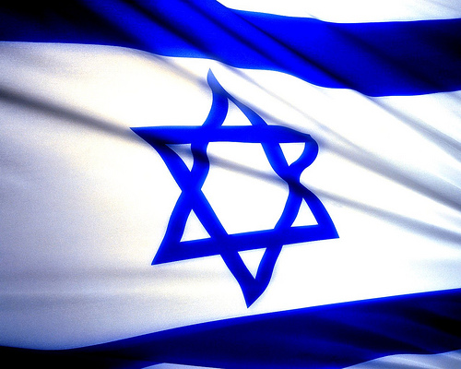
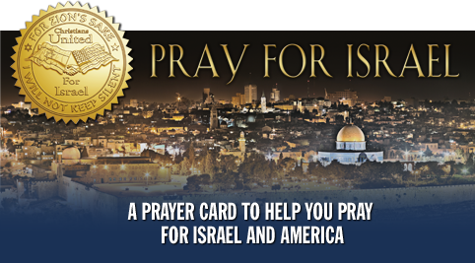

Slide 3
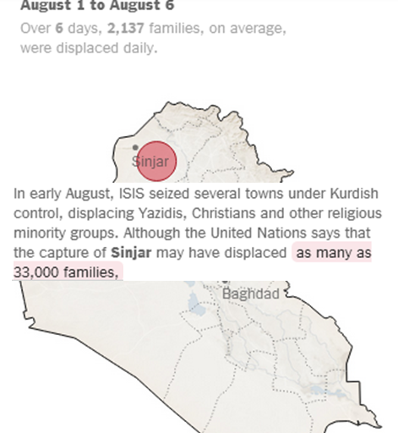
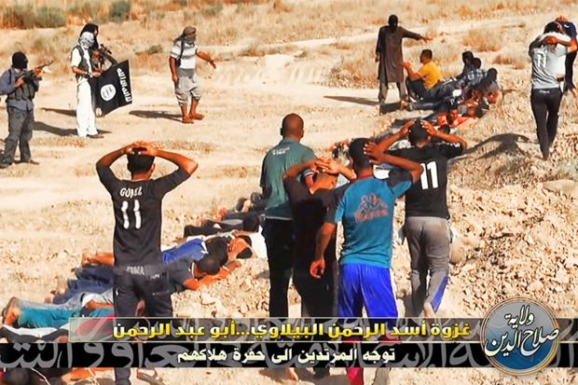
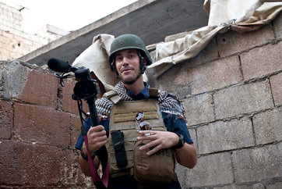
ISIS

Slide 4
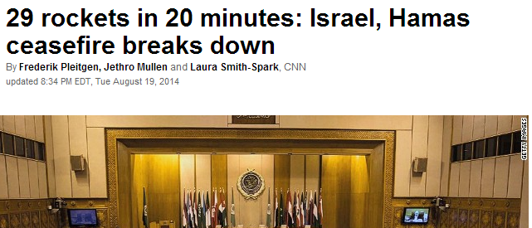
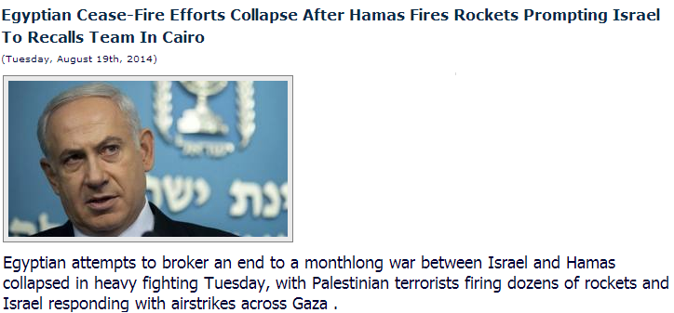
這週發生的事
There was no immediate sign of either side adopting the ceasefire Egypt appealed for on Saturday to allow negotiators from the two sides to return to Cairo to talk about a durable truce.

Slide 5
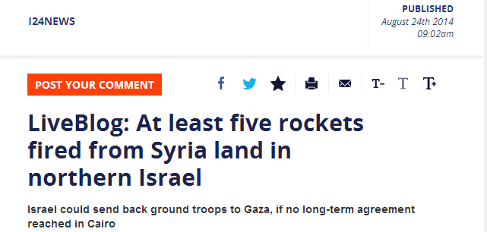
Operation Protective Edge Day 48
48 hours after another ceasefire between Hamas and Israel broke down, rocket fire from Gaza continued into Saturday morning. During the past two days Gaza militants have launched 283 rockets into Israel, 219 of which landed and another 44 which were intercepted, the Israeli army said..
Around 27 people were killed in 50 Israeli strikes across Gaza Thursday, raising the overall death toll to 2,083 Palestinians since July 8. On the Israeli side, 67 people have been killed, 64 of them soldiers.

Slide 6
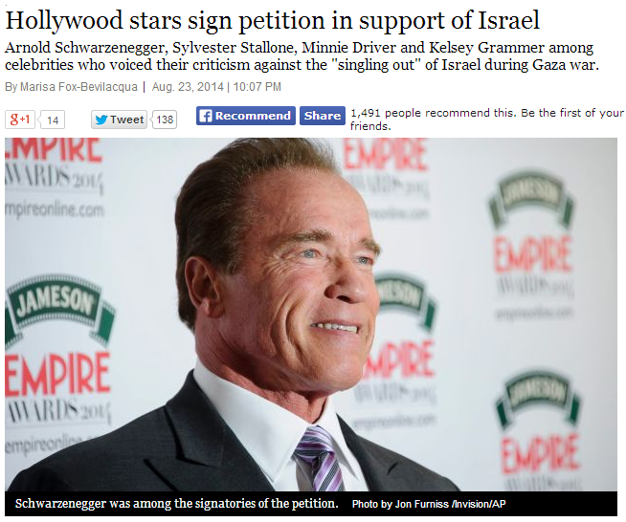
一些好消息

Slide 7
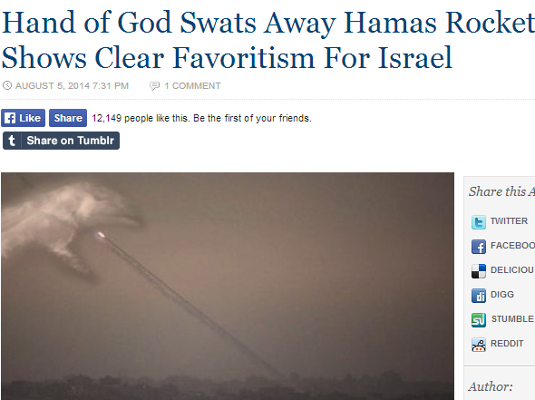
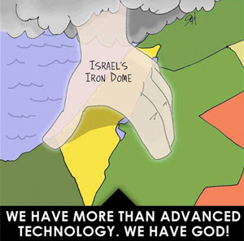
一些好消息: 神的保守
Notes:
8/5/14 Iron dome has had a success rate as high as 90 percent but still missed 2x. 'Suddenly, Iron Dome (which calculates wind speeds, among other things) shows a major wind coming from the east, a strong wind that … sends the missile into the sea. We were all stunned. I stood up and shouted, 'There is a God!,' he said. 'I witnessed this miracle with my own eyes. It was not told or reported to me. I saw the hand of God send that missile into the sea.'

Slide 8
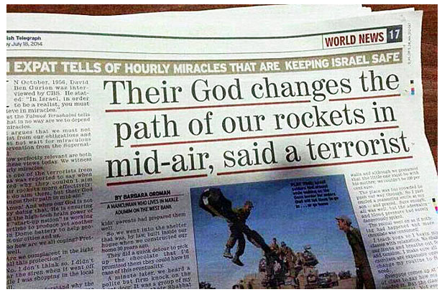
一些好消息: 神的大能彰顯

Slide 9
禱告事項

Slide 10
1. 求神釋放拯救與保護在中東特別在以色列
4 他必用自己的翎毛遮蔽你．你要投靠在他的翅膀底下．他的誠實、是大小的盾牌。 5 你必不怕黑夜的驚駭、或是白日飛的箭(Hamas的火箭)11 因他要為你吩咐他的使者、在你行的一切道路上保護你。(詩篇91:4-5,11)
以色列的牧者啊，你在他們的敵人面前，為你的百姓擺設筵席 (詩篇23:5)
Notes:
a. That if there should be any evil weapons of mass destruction hidden in Hamas’s armory, they would be supernaturally bound from being used against Israel—that they would be uncovered and neutralized.

Slide 11
2. 求神變亂哈馬斯, 恐怖組織一切行毀滅行動切斷他們供應，使他們不能聚集行惡
求神在自然和超自然的領域內切斷對哈馬斯、ISIS及其他的恐怖組織的一切惡魔的力量和供應，釋放天使天軍使他們自亂腳步，當他聚集行毀滅或恐怖行動時, 混亂他們使他們不能成就。
我們用詩篇91篇你的話語禱告你對立約子民的全然庇護。拯救他們脫离捕鳥人的网羅, 不怕黑夜的惊駭, 吩咐你的使者在他們行的一切道上保護他們 。

Slide 12
3. 代表以色列為驕傲悔改使他能轉向神
¹¹ 你要謹慎，免得忘記耶和華─你的神… ¹² 恐怕你吃得飽足，建造美好的房屋居住，¹³ …你的金銀增添，並你所有的全都加增，¹⁴ 你就心高氣傲，忘記耶和華─你的神…
¹⁷ 恐怕你心裡說：這貨財是我力量、我能力得來的.
¹⁹ 你若忘記耶和華─你的神，隨從別神，事奉敬拜，你們必定滅亡；這是我今日警戒你們的。(申命記8)
Notes:
c. That Israel become aware, during this tense time, of areas where she has become vulnerable through her own pride and sin—For conviction by the Holy Spirit and grace to turn in repentance to her God.

Slide 13
4.為着以色列、加沙和中東的靈魂的收割禱告
在苦難中，求神，人類的救贖主，扭轉猶太人和阿拉伯人，使他們的心歸回向神。 求神釋放救贖的光在以色列、加沙和中東這塊地區，釋放耶穌寶血的能力 ，推毀一切仇恨，毀滅的謊言，使人的心甦醒, 使他們來認識真理，使他們在神兒子裏有盼望。

Slide 14
5. 為Netanyahu和以色列領袖禱告
⁹ …願你們在一切屬靈的智慧悟性上，滿心知道神的旨意；¹⁰好叫你們行事為人對得起主，凡事蒙他喜悅，在一切善事上結果子，漸漸的多知道神；¹¹照他榮耀的權能，得以在各樣的力上加力，好叫你們凡事歡歡喜喜的忍耐寬容 (歌羅西書 1:9-11)
Notes:
b. For divine counsel over Israel’s governmental and military leaders as how to proceed—both with the war against Hamas, and quelling the upheaval in Israel and Judea and Samaria.

Slide 15
6. 求神從列國釋放以色列一切所需要的資源
求神從列國釋放以色列一切所需要的資源～包括軍事武器在內的一切資源。同時，興起禱告的軍隊，釋放從神來的幫助與保護進入以色列，因為神的應許說：万軍之耶和華說，"不是倚靠勢力，不是倚靠才能，乃是倚靠我的靈，方能成事。"（撒迦利亞書4:6；以西結書37:1-10） 關于奧巴馬總統停止向以色列出售導彈這件事，我們懇請你怜憫美國。請超自然地翻轉奧巴馬的決定，并其它國家最近停止向以色列提供武器的決定。

